Slide 1
Keeping it Real!
Controlling the Message 2013
MSTPA Annual Conference
Baton Rouge, LA

Slide 2

About A&M
Texas’ first public institution of higher learning
Land-Grant, Sea-Grant and Space-Grant university
Seventh-largest university in enrollment
12,000 faculty/staff, 50,000 students
One of largest campuses – 5200 acres
Home to George Bush Presidential Library and Museum

Slide 3
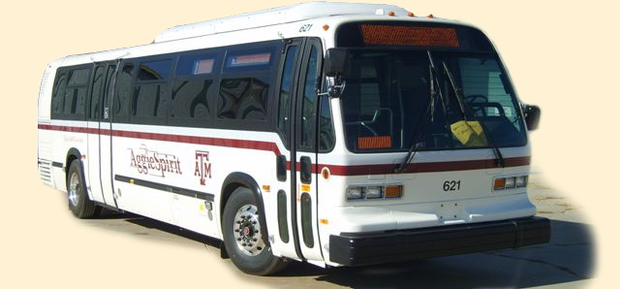
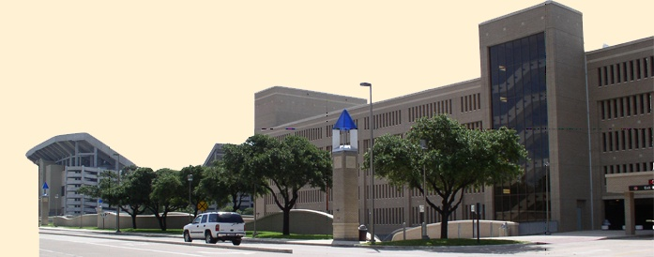
About Transportation Services
36,310 parking spaces
80 buses and 5 paratransit vans operating approximately 121,000 hours each year and 1.4 million service miles
Ridership over 5.4 million/yr
Notes:
Department budget of $30 million
Parking budget of $20 million
Transit budget of $7 million
160 budgeted employees
300 student workers

Slide 4
Do you know what this means?
Te'oing
Driving dirty
Congressional
Deligious
Notes:
The act of of hugging an imaginary person.
Operating an automobile without proper proof of insurance.
to act infantile and obstinate; to reject common sense in favor of self-interest regardless of consequences "My, you are sure acting congressional today. Shame on you.“
A food or beverage that is so delicious that ingesting it is akin to a religious experience.
UrbanDictionary.com

Slide 5
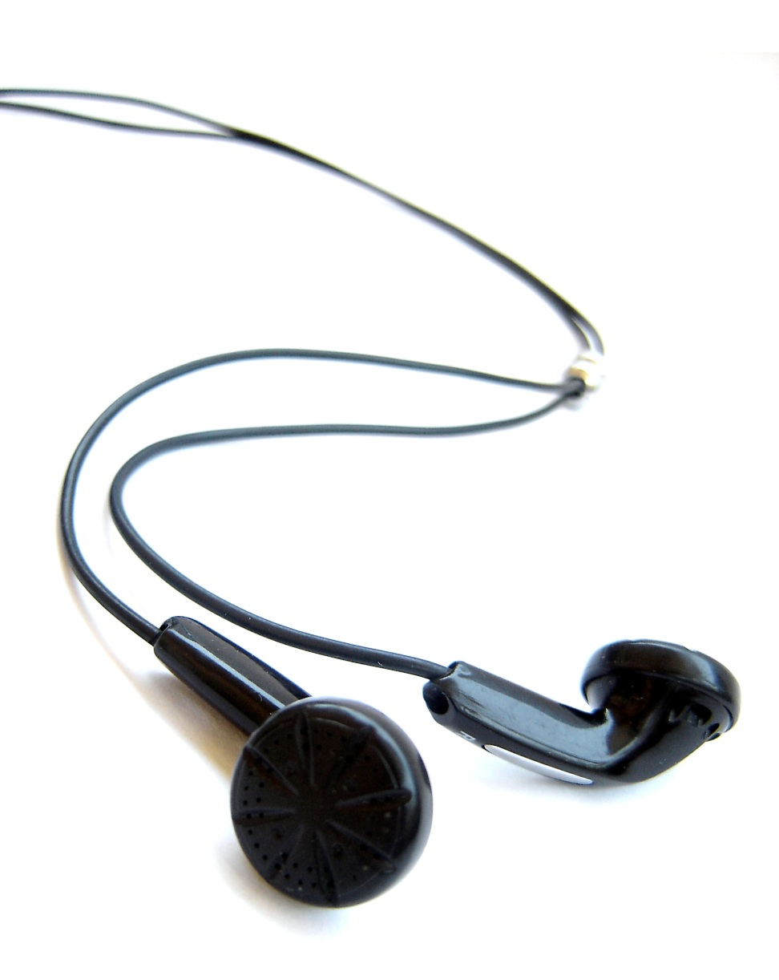
Communicating With Gen Y
:-)
:-)
Cell Phones
Tablets
High-Speed Internet
Texting
Laptops
MP3 Players (iPod)
Phone Cameras
LOL
:P
IMO
<3
IDK
G2G
ROFL
Notes:
These are the most popular ways Generation Y (college-age students) communicate

Slide 6
Generation Y
Graphics oriented, see text as supporting visual methods
  A picture is worth a thousand words
Thrive on change
  Variety = a few things that change frequently
Demand quick, if not instant, gratification
Self-Reliant: Used to doing it (and many other things) themselves, multi-taskers

Slide 7
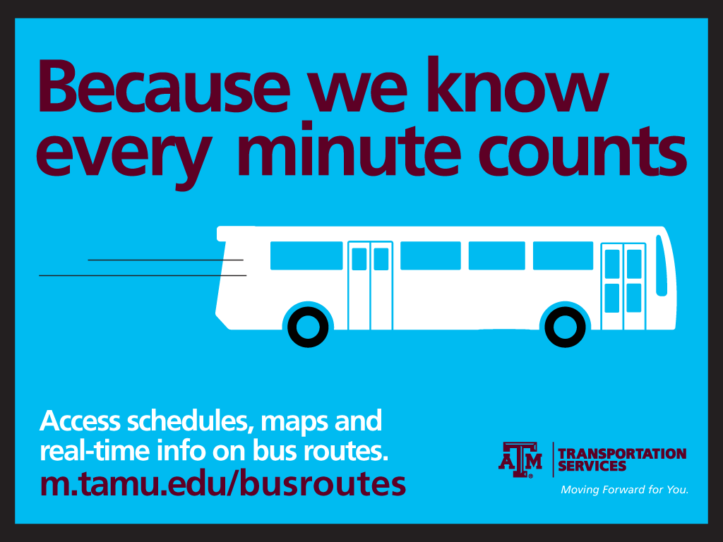
Graphics in Advertising

Slide 8


Slide 9
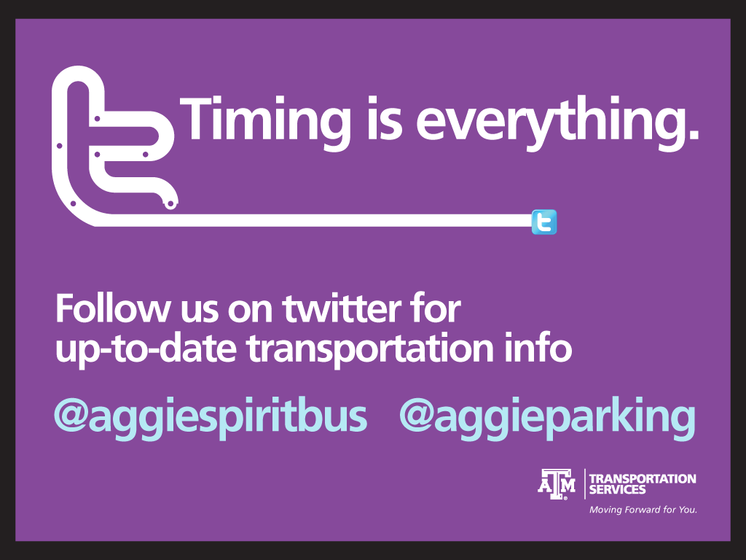

Slide 10


Slide 11


Slide 12


Slide 13
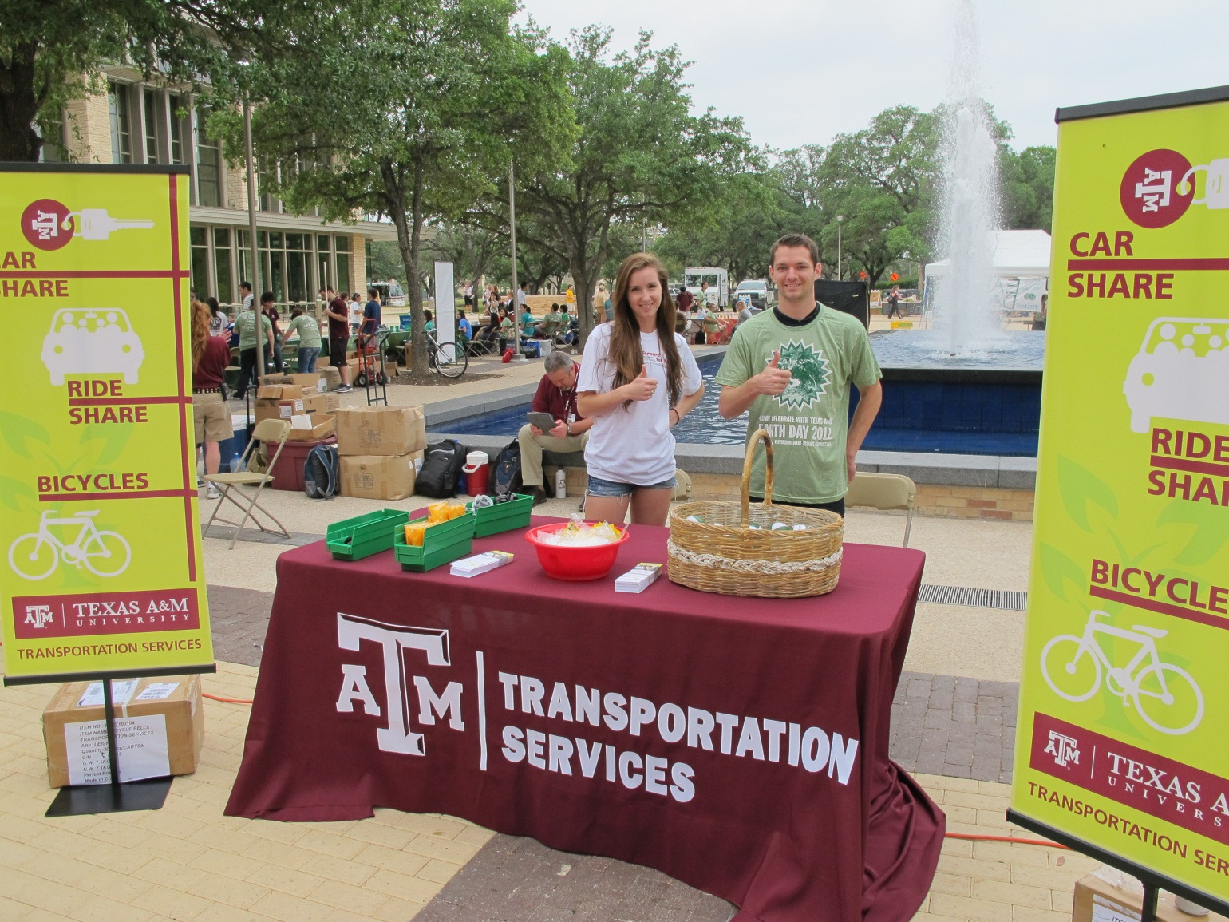

Slide 14
Email Messages
As spring break approaches, I want to quickly remind you of some great services we offer which may help make your break even better and introduce some new services for this semester.
We have teamed up with CampusConnector to offer break shuttle service to Dallas, Waco, Austin, Houston and San Antonio for only $35 each way! Find out more and sign up for the spring break shuttle at http://www.breakshuttle.com/collections/all-schools/products/texas-a-m-university-break-shuttle
There is also a FREE ride share service through Zimride. This program connects Aggie drivers and riders who need to travel near or far. Share a ride this spring break! For more information visit our website at http://transport.tamu.edu/parking/rideshare.aspx
We also offer a car share program through Hertz on Demand! Students 18 years old and up with valid driver’s licenses can rent vehicles for as low as $8/hour which includes gas and insurance! Check it out at http://transport.tamu.edu/parking/carshare.aspx
Bikes may be leased by the month, semester or year through a partnership with MaroonBikes and we offer a borrow-a-bike program for a FREE, one day bike loan. Learn more at http://transport.tamu.edu/bicycles.aspx

Slide 15
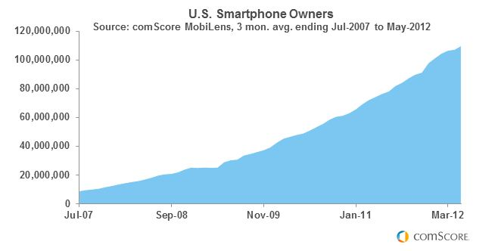
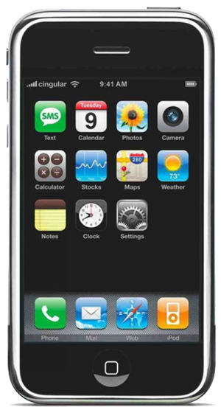
Smartphones
In July 2007, barely 9 million Americans owned a smartphone (4% of the mobile market)
In July 2012 nearly 110 million Americans owned a smartphone
Original iPhone introduced June 29, 2007
Notes:
Smartphones have been around for decades but the release of the original iPhone its Safari browser reinvented mobile browsing

Slide 16
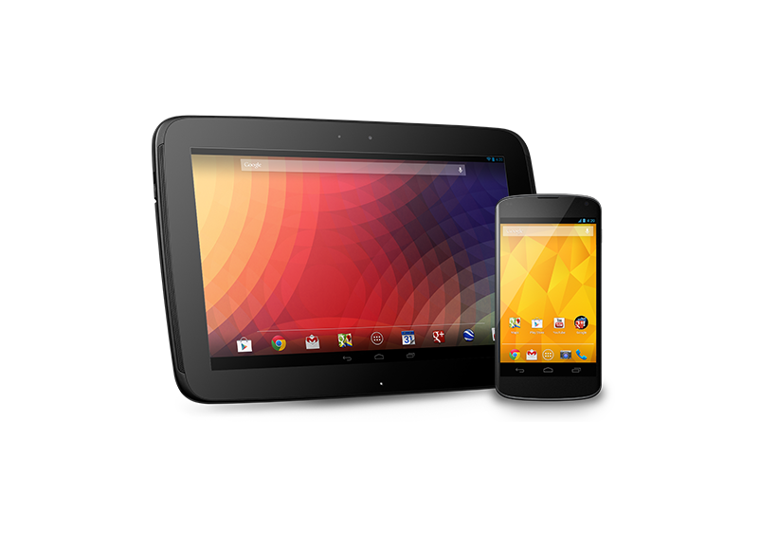
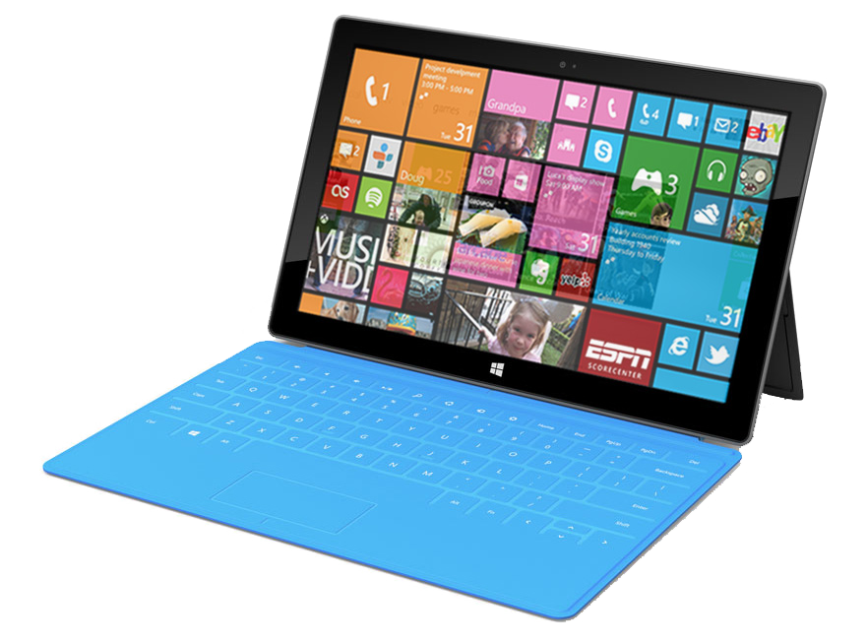
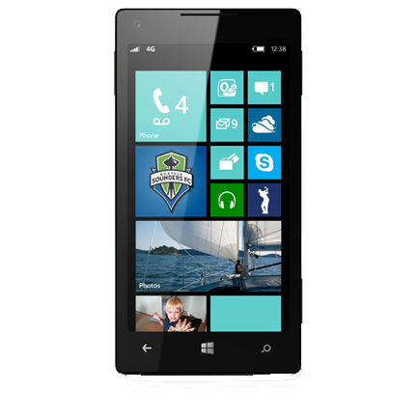
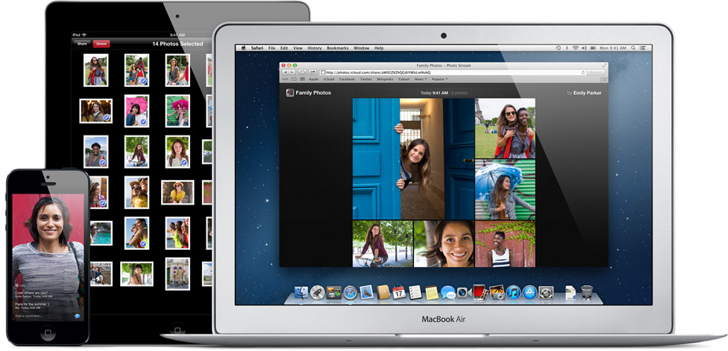
The mobile web
Over 5 billion devices connect to the internet
Over 22 billion expected within 10 years
Users spend 9% more time browsing on a mobile device than on a PC
Notes:
Hundreds of devices in use today – and hundreds more that haven’t even been made yet

Slide 17
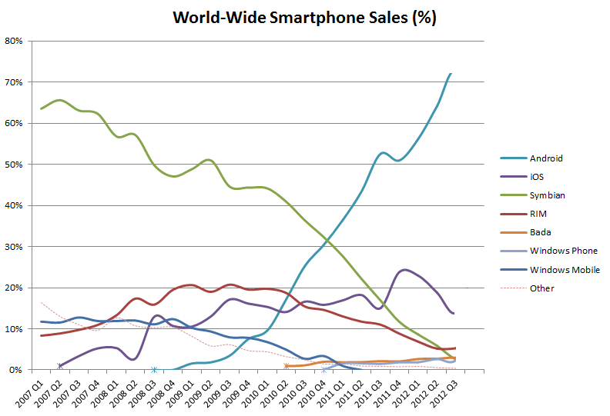
World-Wide Smartphone Sales
2007-2012
Nokia
Android
iPhone
Blackberry
From Wikimedia Commons freely licensed media file repository under the Creative Commons Attribution-Share Alike 3.0 Unported license
Notes:
Market can change drastically over a few short years. You don’t want to put all your eggs in one basket.

Slide 18
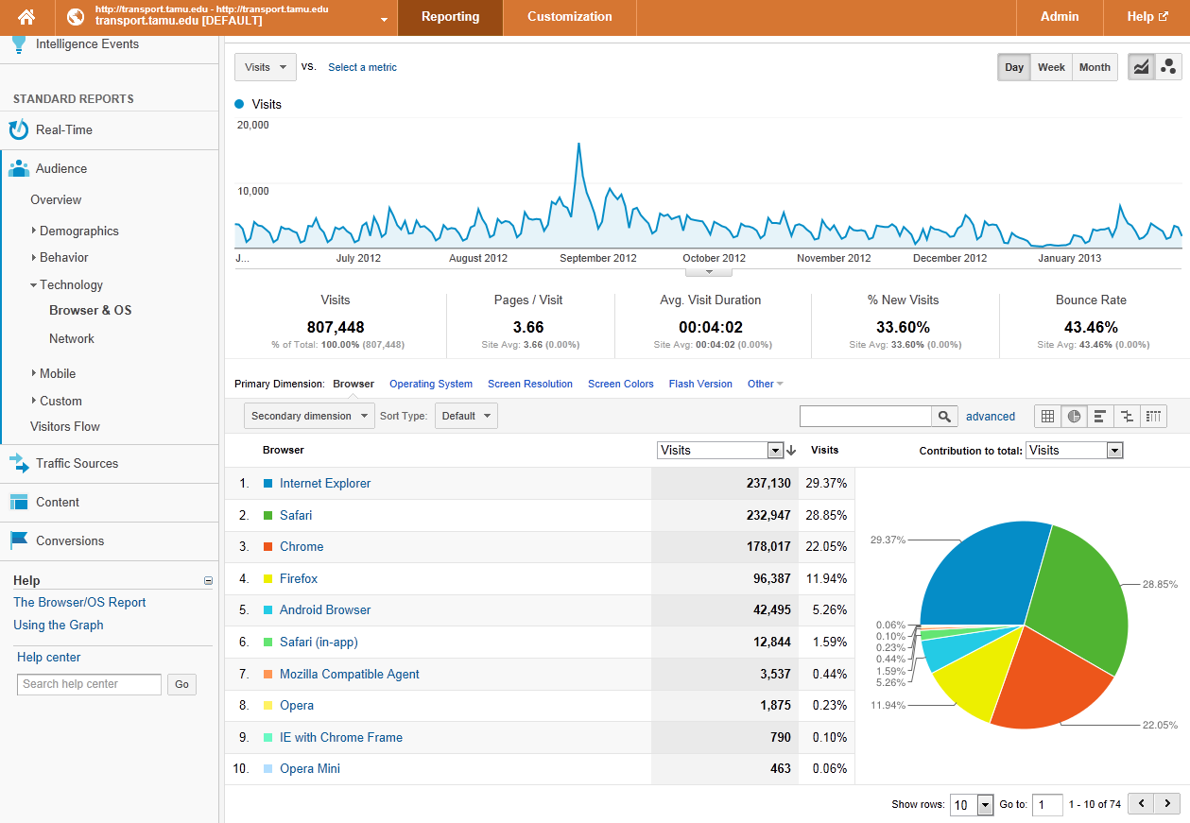
Free Tool: Google Analytics
Notes:
Google Analytics – free analytics tool to view usage, device, location, etc

Slide 19
Who are YOUR customers?
{
Lots of other stuff
BlackBerry
1%
Windows Phone
1%
Other
< 1%
Mobile/
Tablet
23%
Android
25%
Desktop/
Laptop
77%
iPhone
56%
iPad
16%
iOS
73%
Transportation Services site
May 30, 2012 - Feb 11, 2013
Notes:
You need to do your research
Google Analytics can provide this information to you
Just because iOS dominates in the university setting doesn’t mean that you can ignore the other quarter of your customers

Slide 20

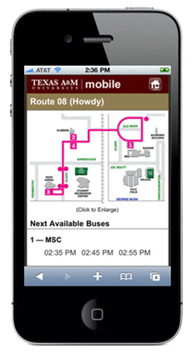
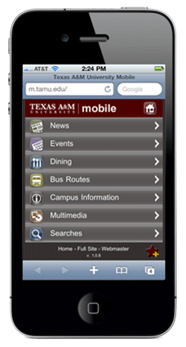
Mobile App | Mobile Website
Requires download | Available in any browser
Device-specific | Device-agnostic
Requires download to update | Updates are applied instantly
Content shared between users of app | Content shared with anyone
Take up space on the device’s hard drive | Memory used while page is open
Expensive to develop for multiple platforms - different expertise, development licenses | Can be written using a variety of tools using static HTML to dynamic content
Requires approval from device manufacturer app store | No approval required from device manufacturer app store
Allow for notifications (pop-ups) outside of app | No notifications once user leave the browser
Internet connection not required once app is downloaded | Internet connection required
Access to functions of device | Access to limited functions of device (location, files) – iOS6 added camera access
Notes:
Unless you have a very specific application, a mobile website is your best bet. Cheaper, faster, device-agnostic
Apps require specialized skills and tools
We don’t have the resources for an app
If you have existing web resources then you should be able to create a mobile-friendly website.

Slide 21
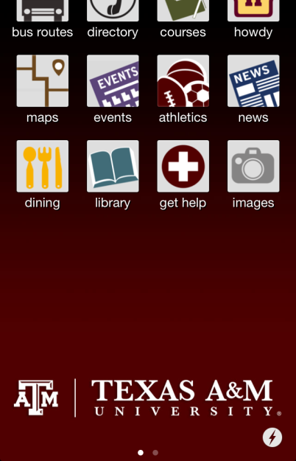

Hybrid
Notes:
Some choose a hybrid model
A&M app links to our mobile bus routes website

Slide 22
Responsive Web Design
“Rather than tailoring disconnected designs to each of an ever-increasing number of web devices, we can treat them as facets of the same experience. We can design for an optimal viewing experience, but embed standards-based technologies into our designs to make them not only more flexible, but more adaptive to the media that renders them. In short, we need to practice responsive web design.”
-- Ethan Marcotte
A List Apart, Responsive Web Design, May 25, 2010
Notes:
Responsive web design coined in an article by Ethan Marcotte
Basically – rather than trying to design for every device out there, designs should be flexible so that they are usable on any device

Slide 23
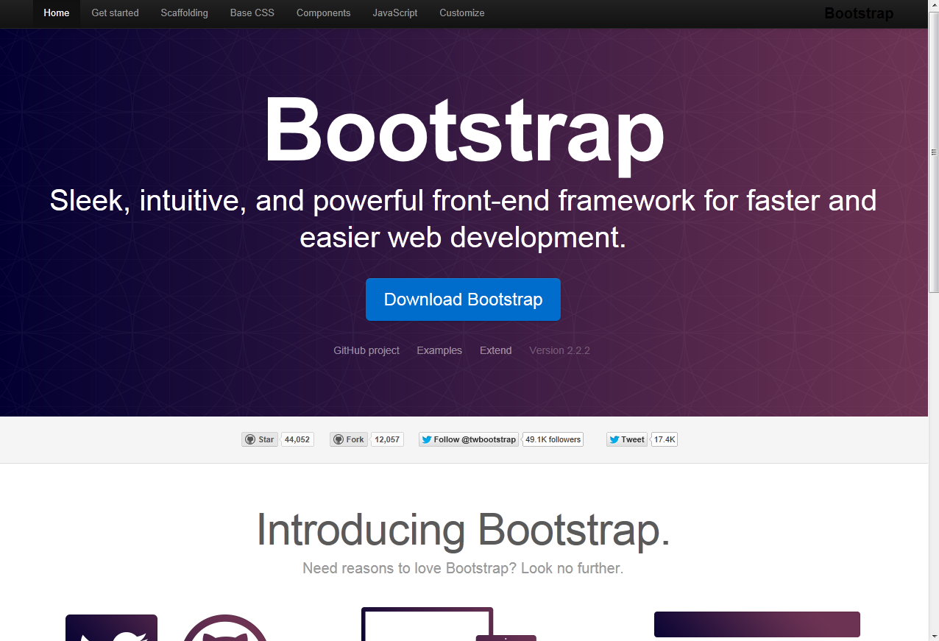
Free Tool: Bootstrap
Notes:
Twitter Bootstrap – free customizable template and framework that reformats the content based on the width of the viewport

Slide 24
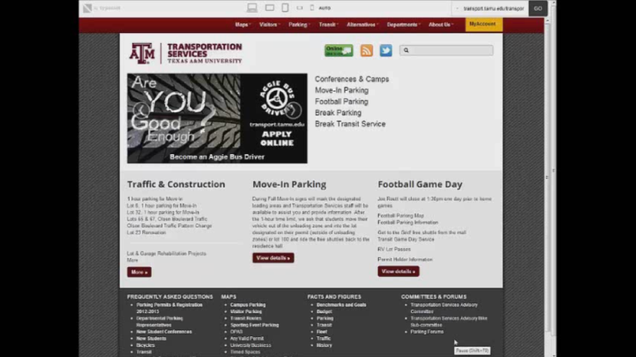
Free Tool: Responsive.is
Notes:
Here’s an example of responsive design. We are developing a new website using boostrap.
Bootstrap has built-in tools for dropdowns, banners and easy layout. It makes it easy to build a site that looks good on any screen size.
This free tool Responsive.is allows you to see what your page will look like when viewed from different screen sizes.
You can view your site today through this site and see what changes you might want to make.

Slide 25
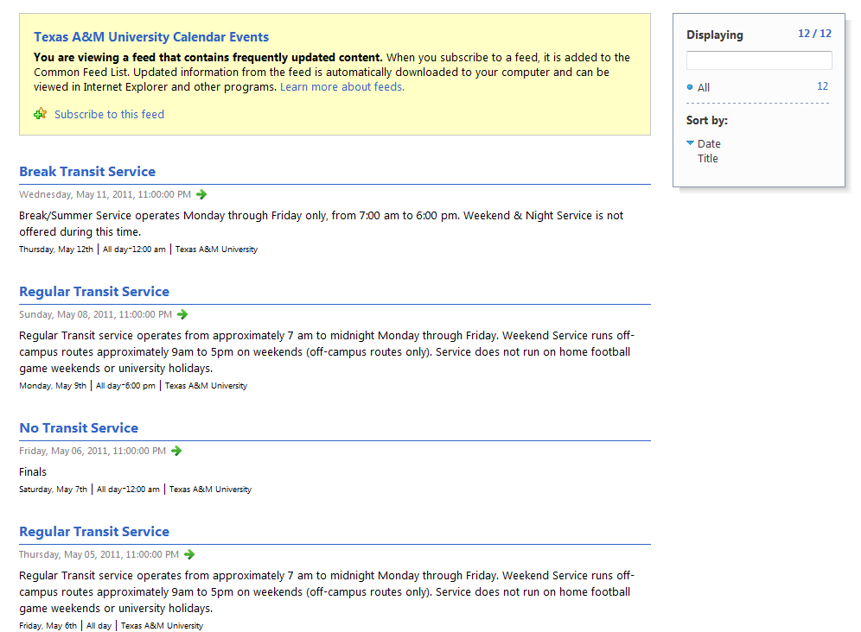
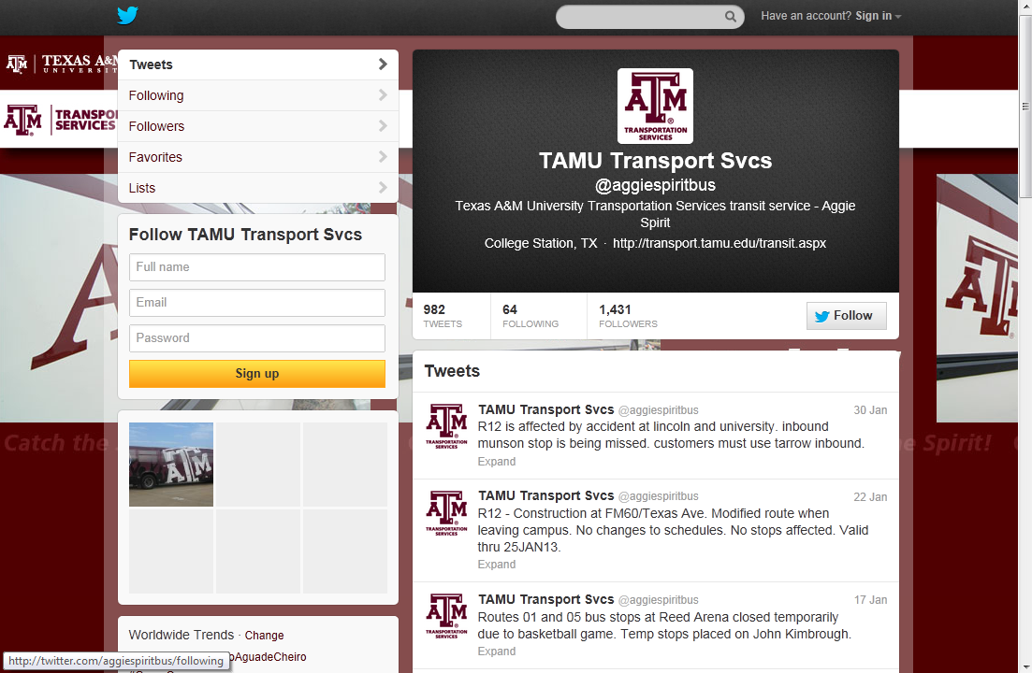








Social Media
Twitter
RSS feeds
Facebook
Notes:
Twitter has 140 character limit, URLs are shortened to 20
Shooter – buses moving – twitter vs code maroon
RSS – Really Simple Syndication – we use more for long term messages
Facebook
- staffing
- maintenance
- spam
Our university president tweets, also sends to us for issues, one of the most followed university president

Slide 26
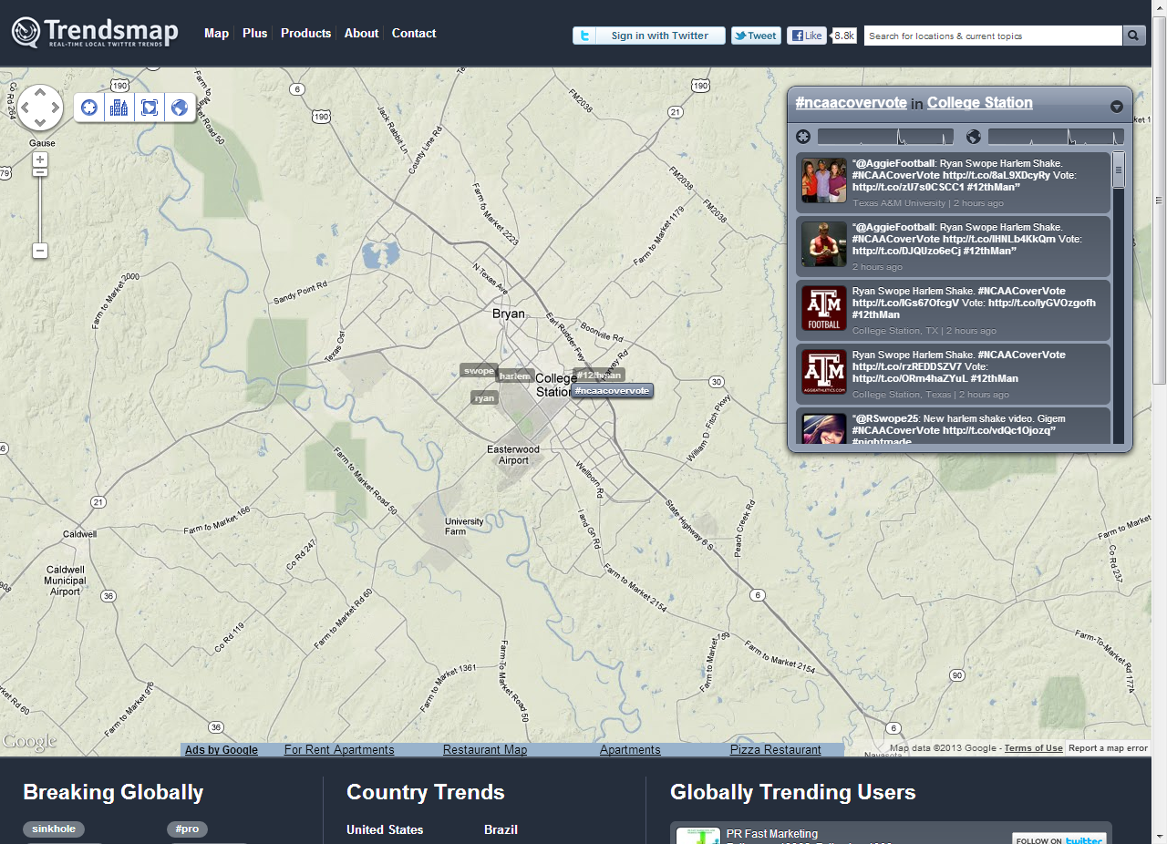
Twitter Trending
Notes:
TrendsMap.com is a site that tracks popular subjects on Twitter by geographic location so you can see what people in your area are talking about.

Slide 27
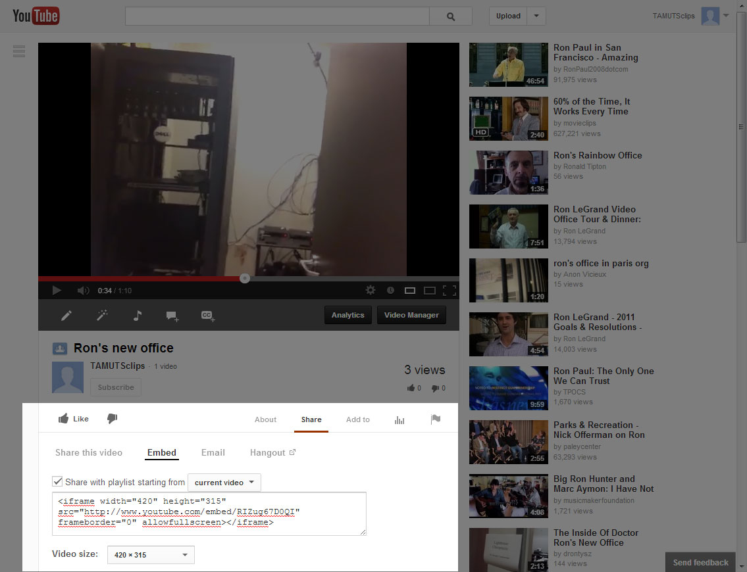
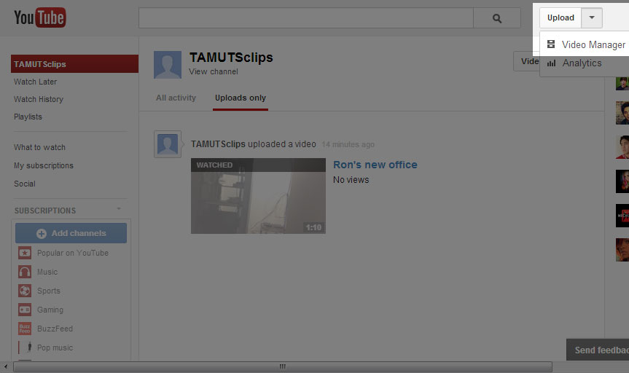
YouTube
Notes:
YouTube
This is how easy it is to add video to your site

Slide 28
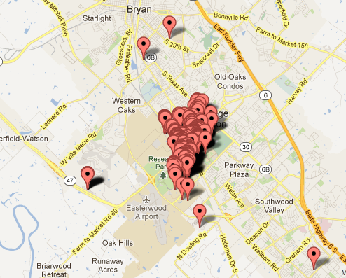
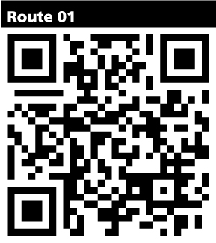
QR Codes
Fall 2012
QR codes on bus stop signs
Last Fall: 1240 hits Past Year: 2076 hits
Notes:
University mobile site
- we post transit leave times, maps and twitter feed
QR codes – most commonly used as a URL but can also embed email, phone, YouTube video or any other text up to 4, 296 characters
Bus banners
Free to create, paid sites offer tracking and link changes
BeQRious - $720 for 2 year renewal
Geolocation
Devices
Link Changes

Slide 29

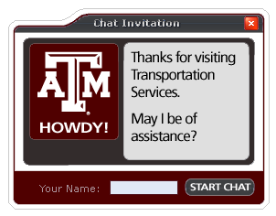
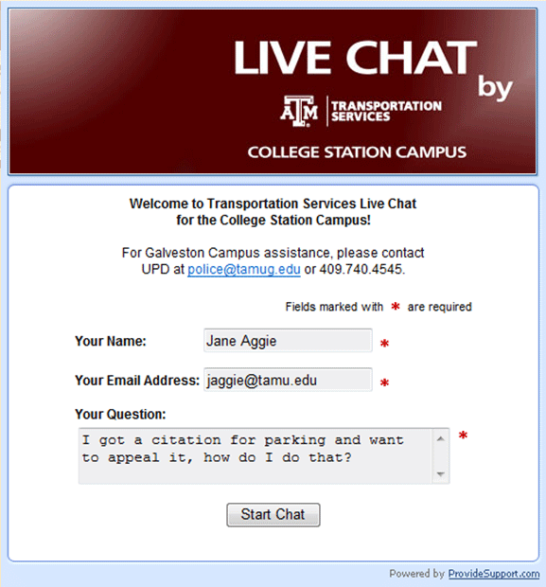
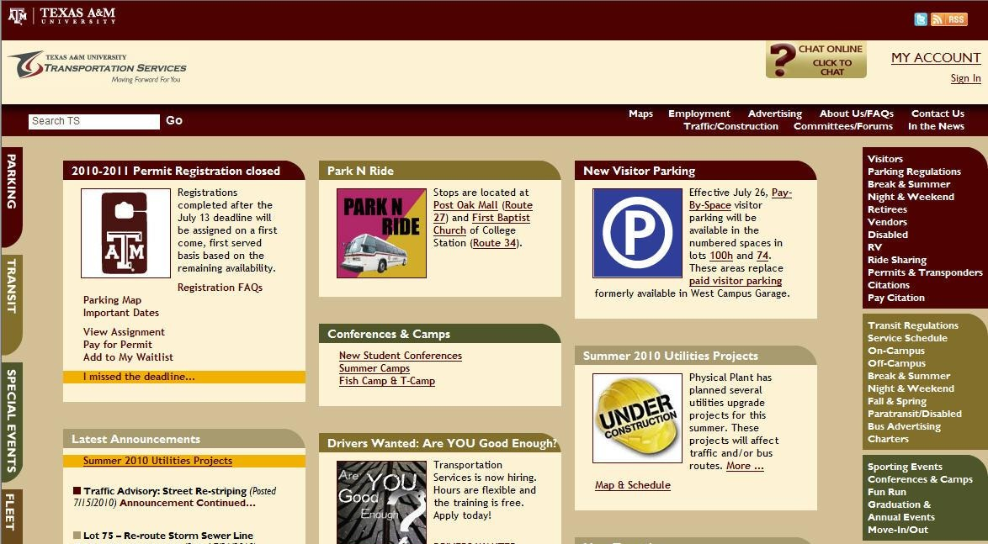
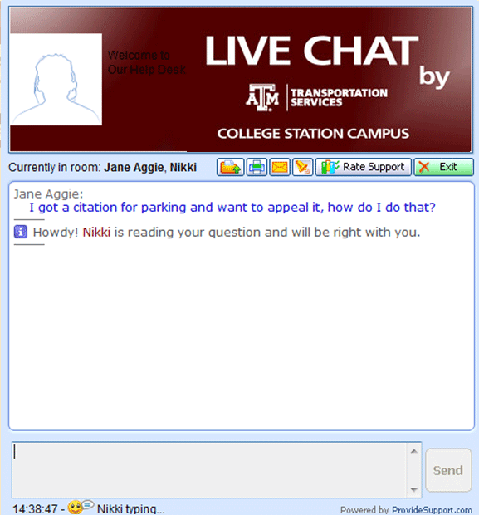
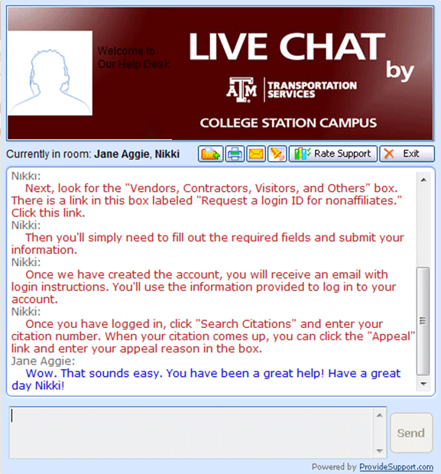
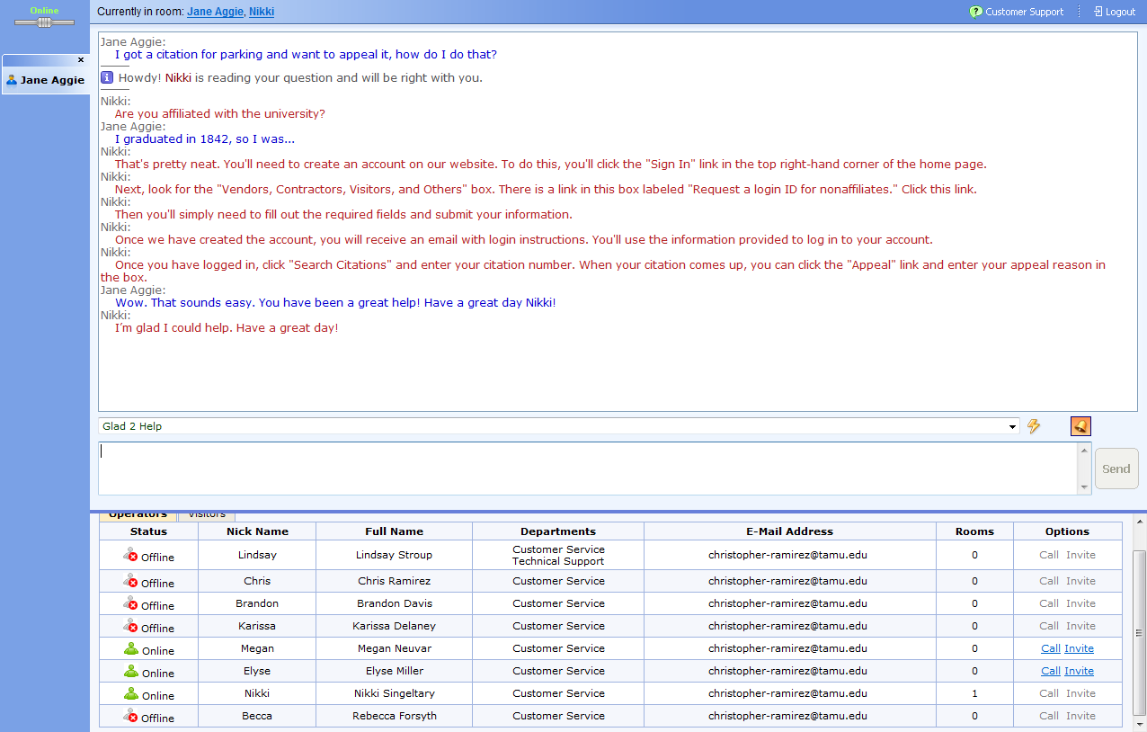
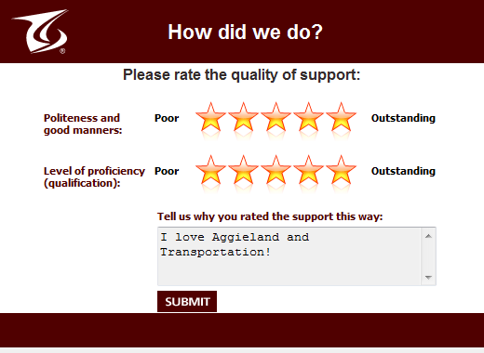
Click to Chat
Notes:
We pay $396 a year for the service.
average of 150 chats per month. we only answer chats from 8am – 5 pm Monday through Friday. There are definitely more during football season, RV renewals, permit registration and the beginning of school. The subjects vary depending on what’s happening on campus.
We also use On-Line Chat to determine if we need to make changes on our website…for example…if people are asking a lot of the same questions, we may need to look at changing some wording to make it more clear for our customer.

Slide 30
Tell Your Story!
source
Admin
Customers
Peers
Local media
Notes:
Have a point person who handles media questions, contact for publications, surveys, student interviews, etc – this person then facilitates the response and or interview – the tone must remain consistent throughout communications whether internal or external : the organization must speak with ONE CLEAR VOICE in order to build upon a clear and positive message
WE make opportunities happen – new product introduction, new ways to communicate – 2-way ( online chat, pay by cell, mobile apps, etc ) reminders about bus service, educating our customers about the use of a service – car share, bike share, green initiatives
Use student newspaper, website, intranet, radio if possible – free PR through news outlets when sent as press release…, student involvement at resource tables, university news , trade publications, industry organizations
Positive Public relations is your source of loyalty, credibility and trust –
WHY – this is how attitudes are changed and then maintained in a positive way

Slide 31
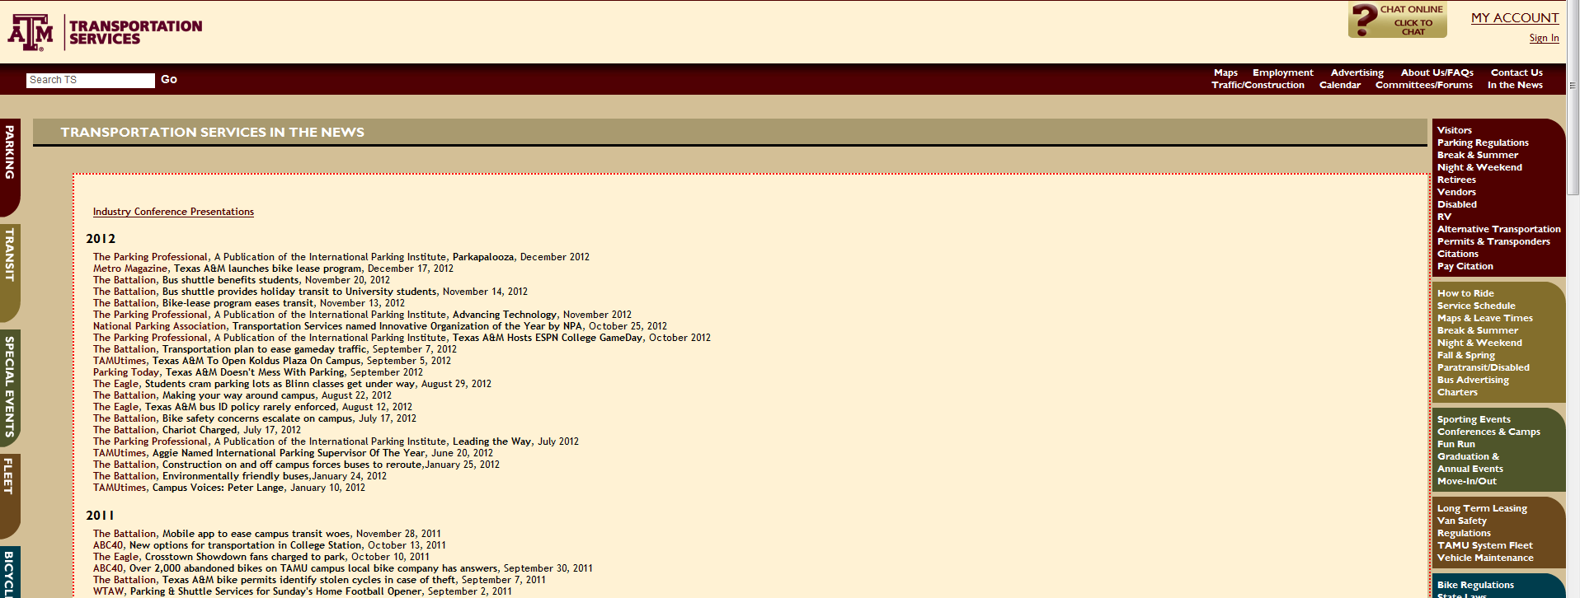

Slide 32
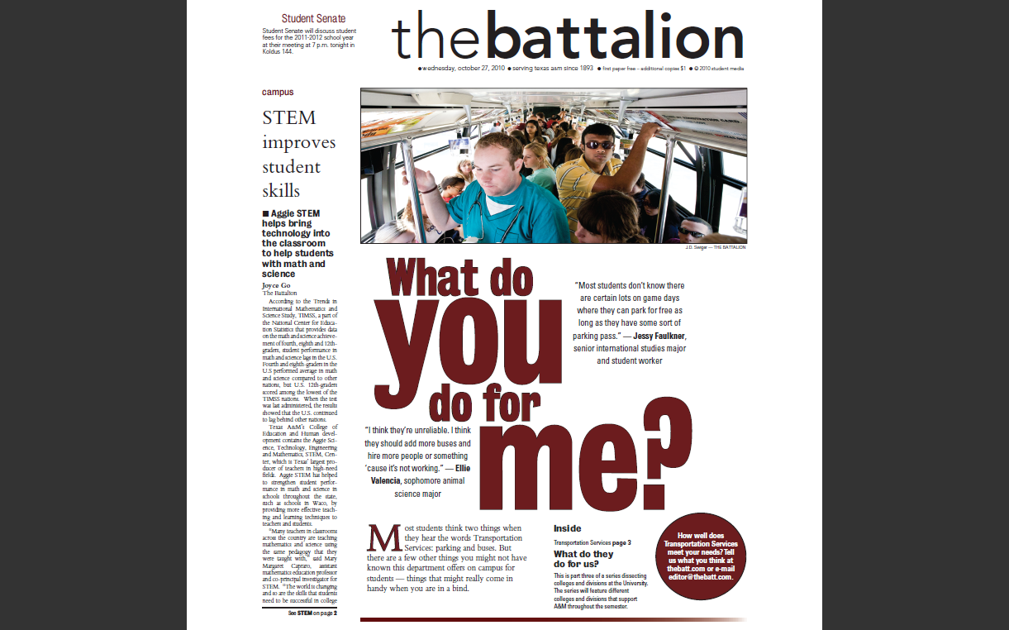
Student Newspaper

Slide 33
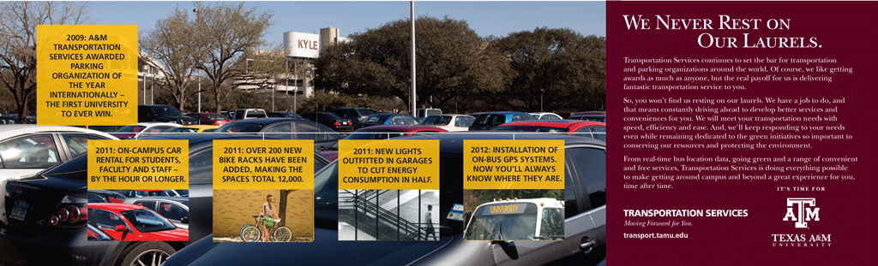

Slide 34
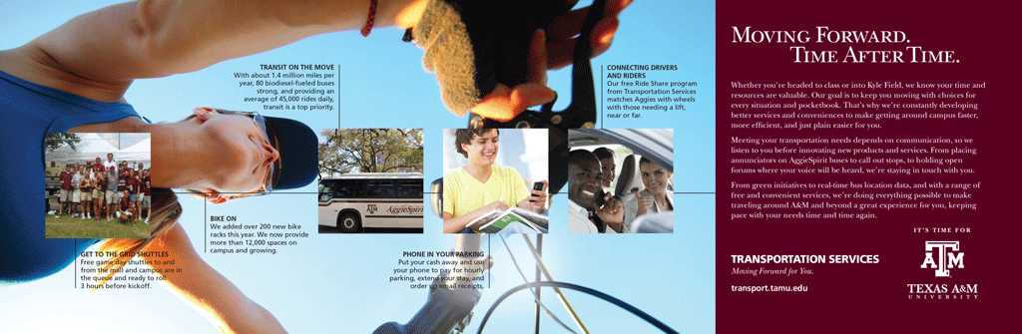

Slide 35
June Broughton
june@tamu.edu
Jennifer Le Grévellec
jenniferl@tamu.edu
Presentation available online:
http://transport.tamu.edu/presentations

